Slide 1


Deep Learning Theory and Applications Transformers
CPSC/AMTH 452
CBB 663

Slide 2
Outline
RNN review
Sequence transduction tasks
Attention
Self Attention
Multi-head Attention
Positional Encoding
Transformer Architecture
GPT2/3

Slide 3
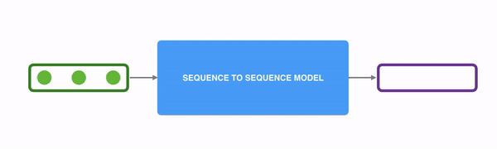
Sequence Transduction
Tasks that require translating one sequence to another generally need some form of memory
to remember the sequence

Slide 4
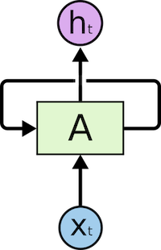
Recall RNNs
The feedback in the state allows for information from one step to pass to the next step

Slide 5

RNNs for Text
Sequence of words in a sentence can pass information from one to the next to allow for accumulated understanding

Slide 6
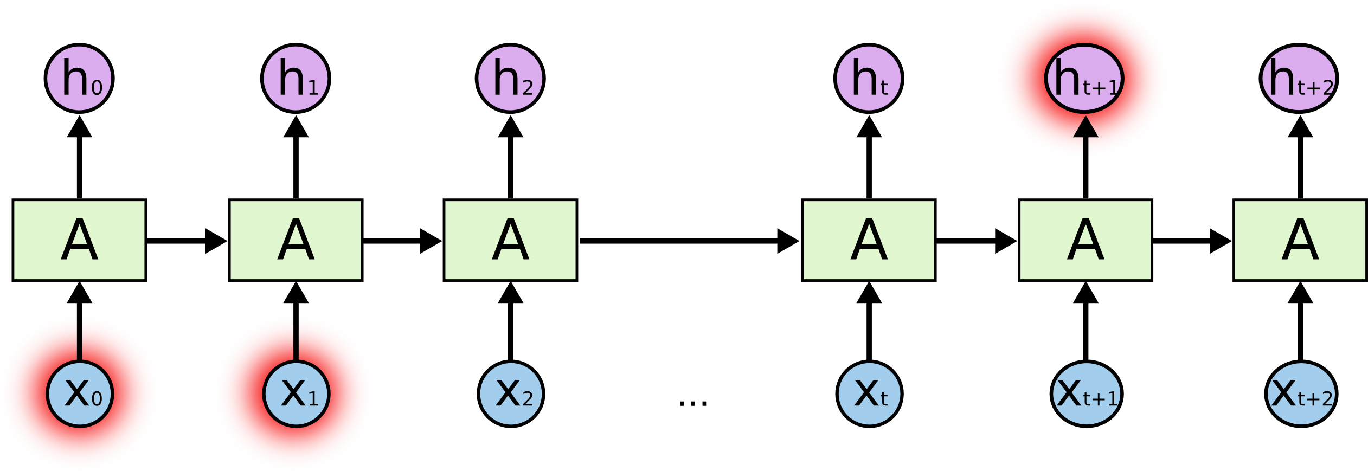
Problem with RNNs for seq-to-seq translation
RNNs have trouble remembering information that is in the past.

Slide 7

LSTMs don’t fix problem entirely
LSTMs have persistent states that are updated by gates, which improves performance but still not optimal

Slide 8
Transformer
CAE + Attention

Slide 9
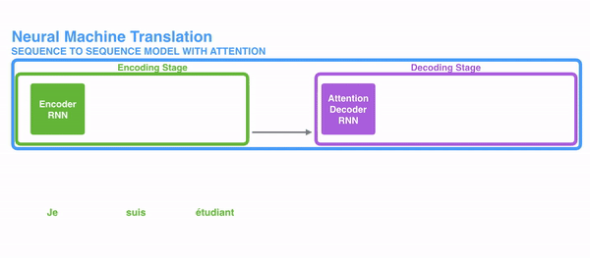

Slide 10

CNNs for sequences
Easy to parallelize
Can exploit dependences
dilated convolution: Distance between positions is logarithmic

Slide 11

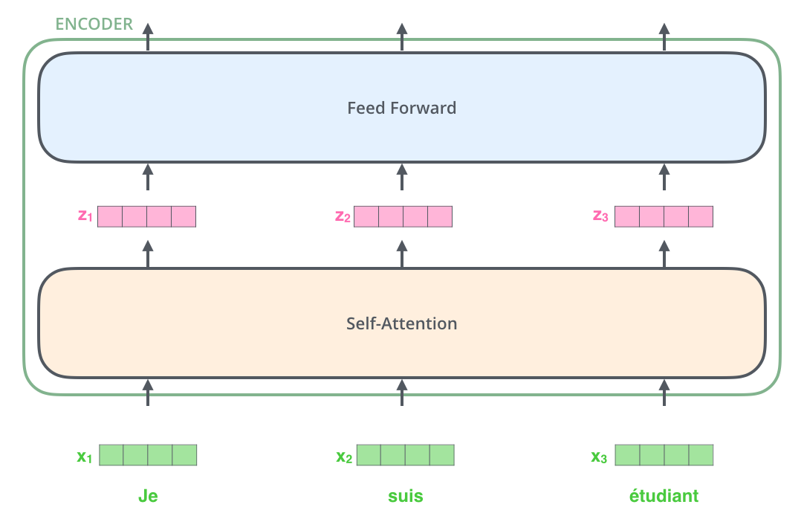

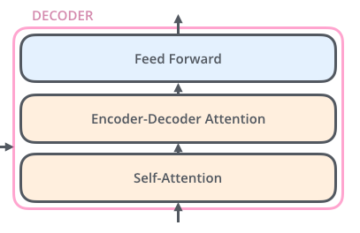
Architecture (simplified)
Encoder
Decoder

Slide 12
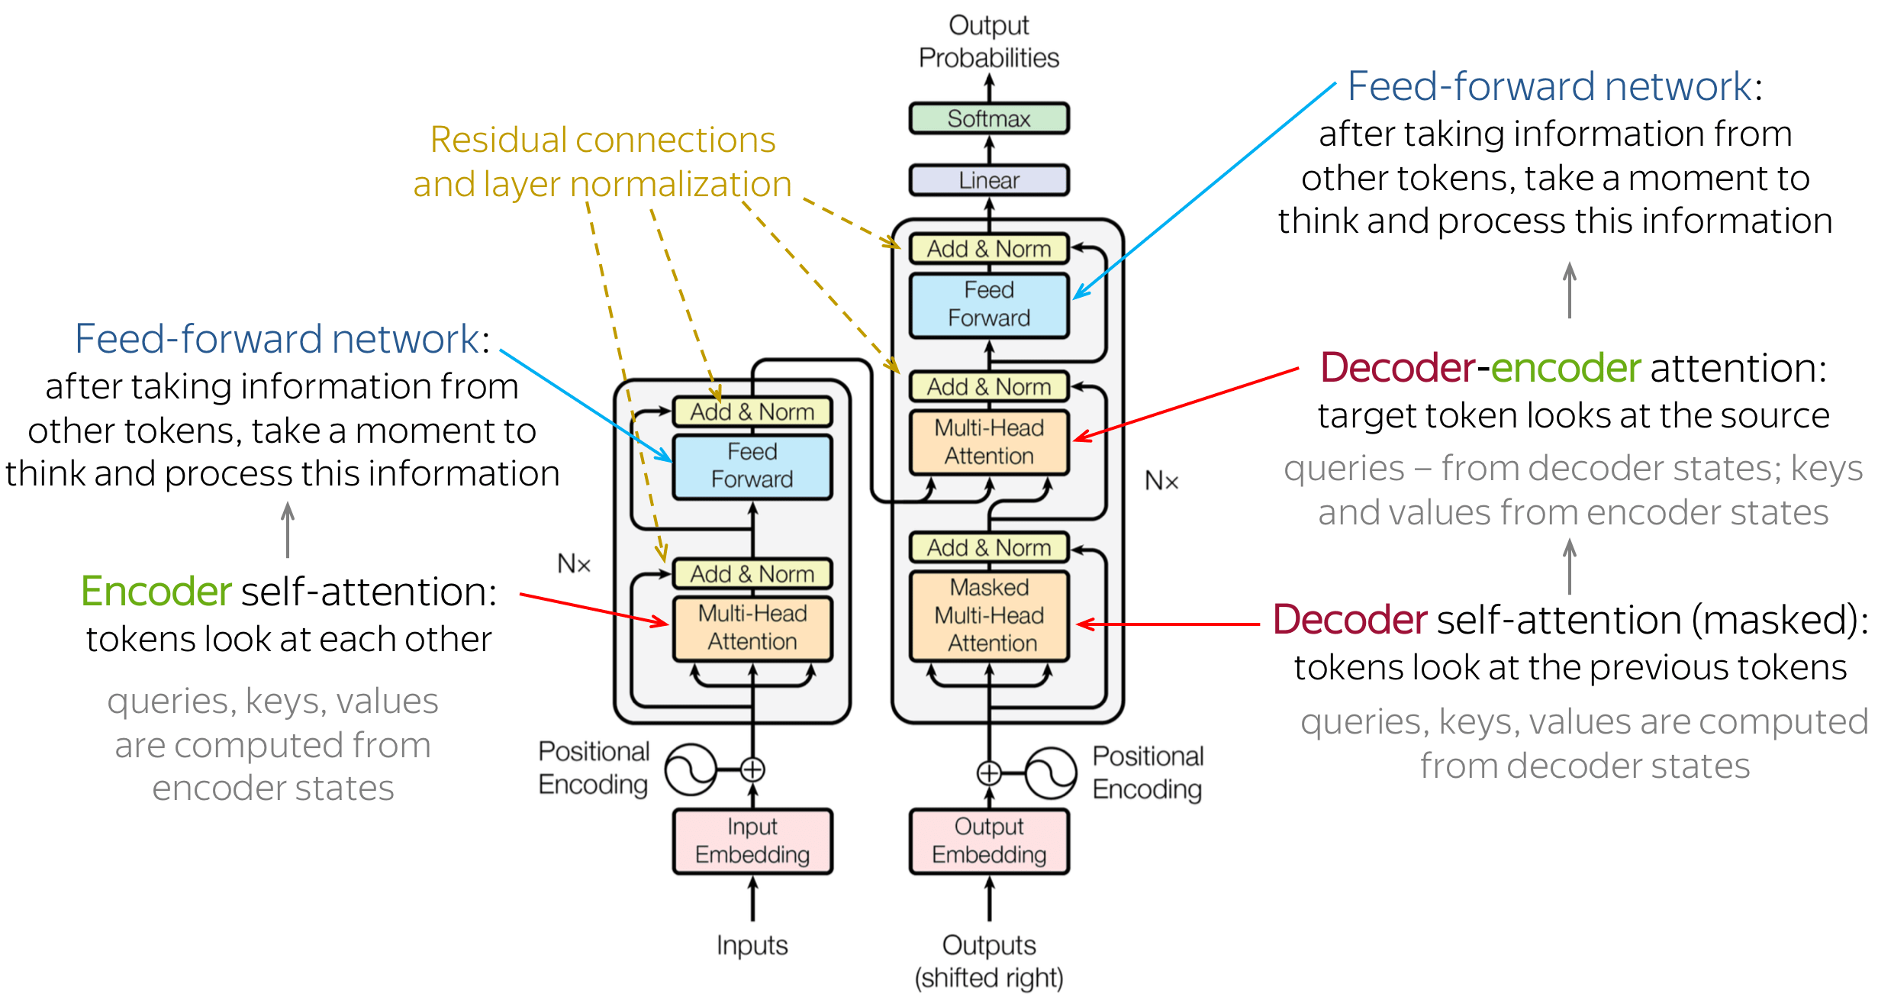
Architecture

Slide 13
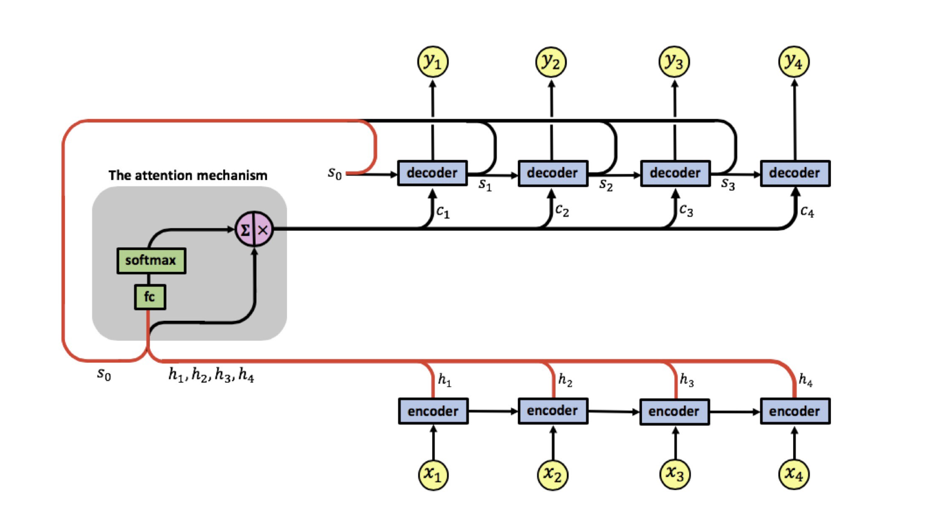
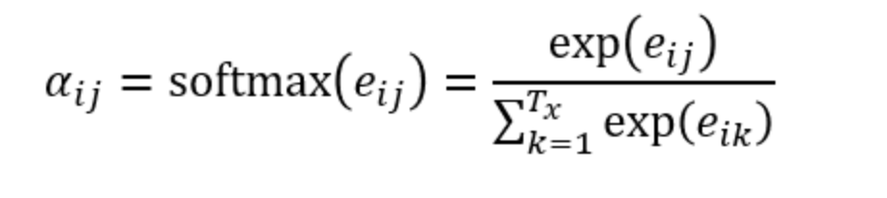
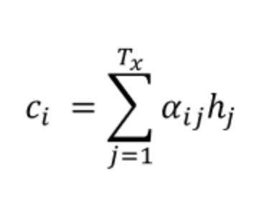
Attention: Adaptively Allows Decoder to Choose Inputs

Slide 14
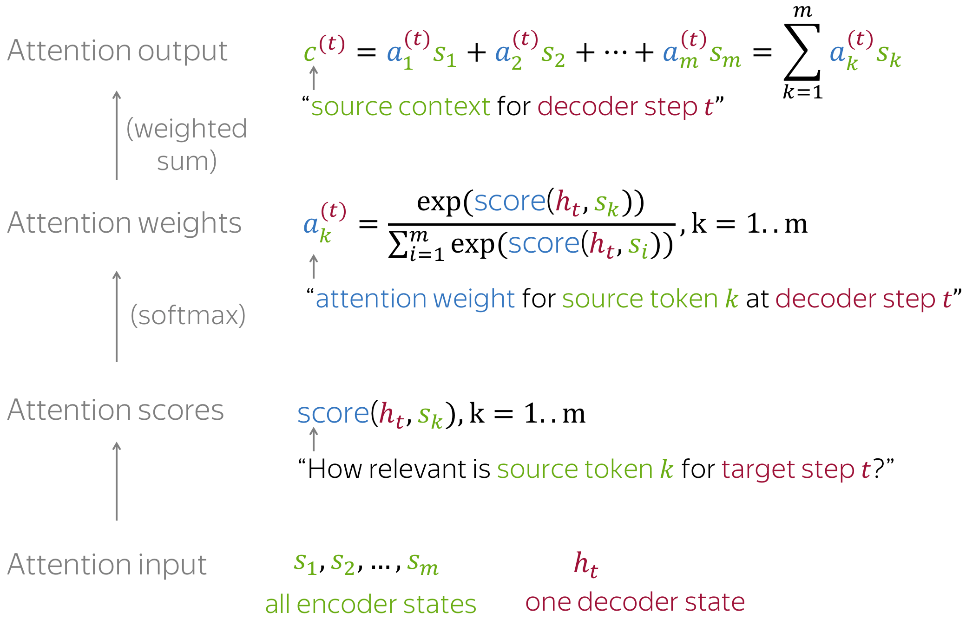
Attention Computations

Slide 15
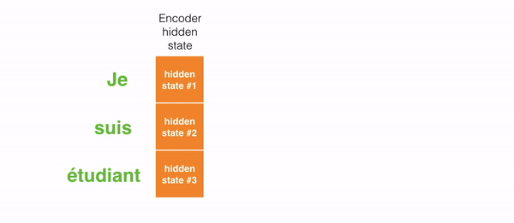
Attention Weights

Slide 16
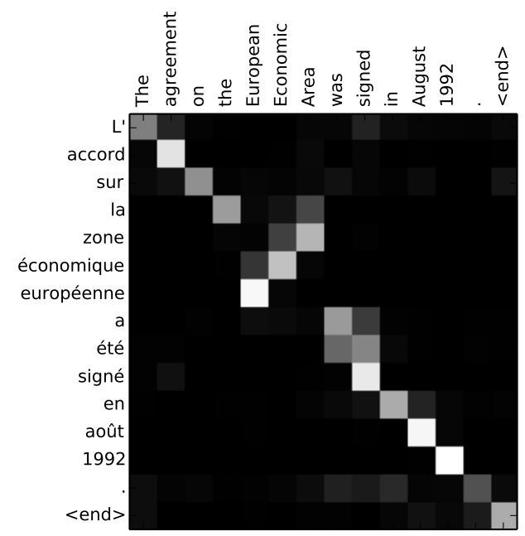
Attention Mechanisms

Slide 17
Each Encoder has Self-Attention

Slide 18
Each Decoder also has self-attention

Slide 19
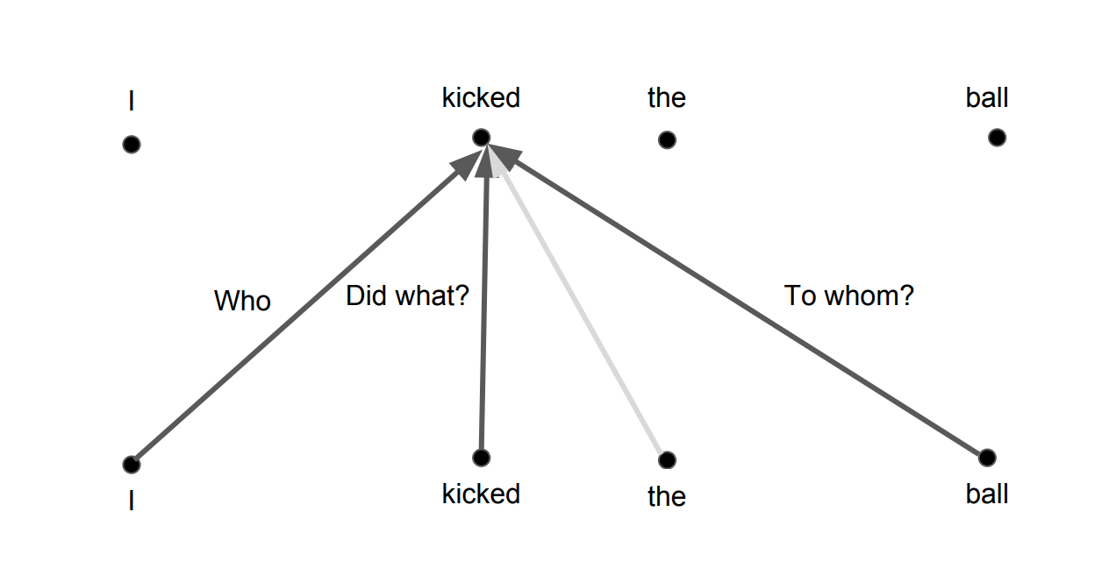
Self Attention

Slide 20
Filing Cabinet Analogy: query, key, value

Slide 21

Query, Key, Value

Slide 22
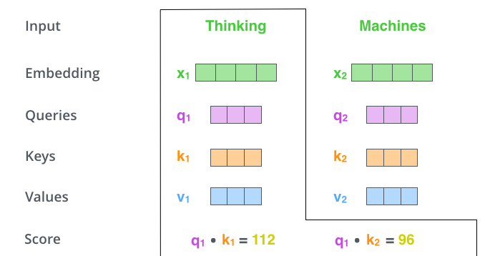

Slide 23

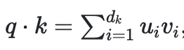
Why the scaling?
Assuming q and k are d_{k} dimensional vectors
The dot product is
This has mean 0 and variance d_{k}
Want to normalize to have variance 1

Slide 24
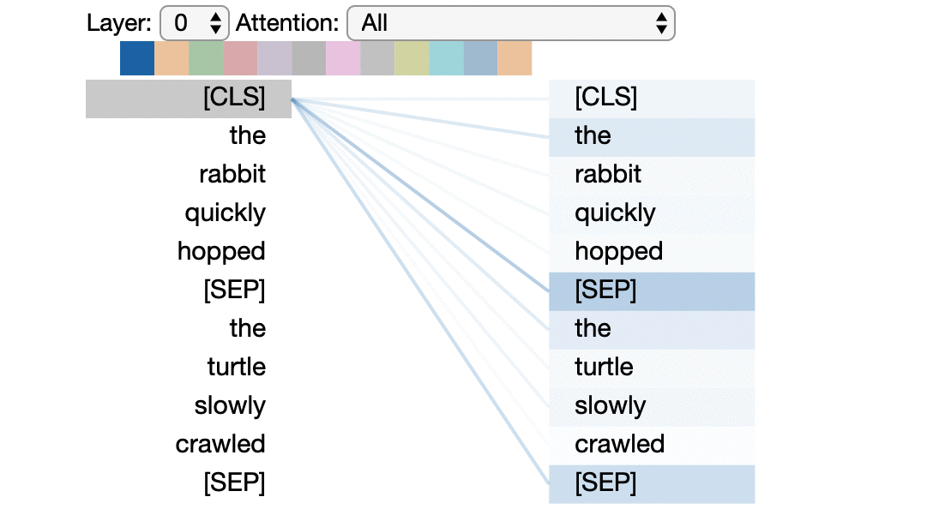
visualize self-attention

Slide 25
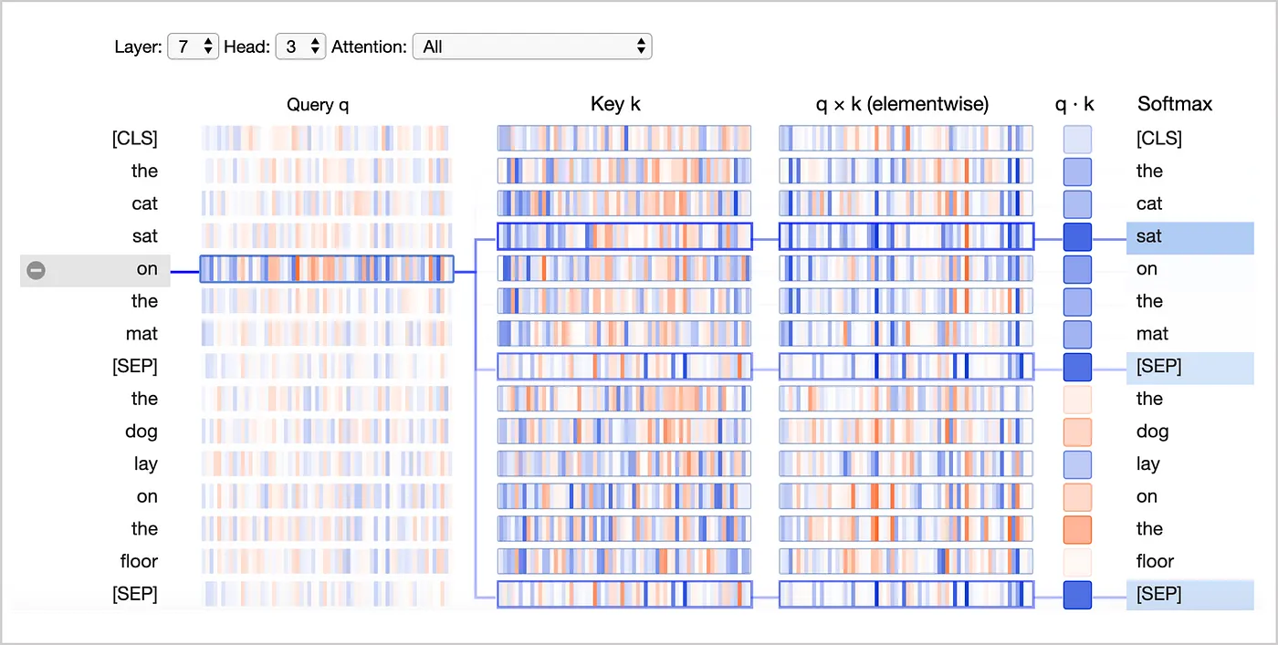
attention score visualization
on layer 7 and head 3 of BERT: token “on” mainly attend to 3 tokens sat, [SEP], [SEP]
(attention score
dot product)
color intensity: magnitude of attention score
Positive values: blue and negative values: orange

Slide 26
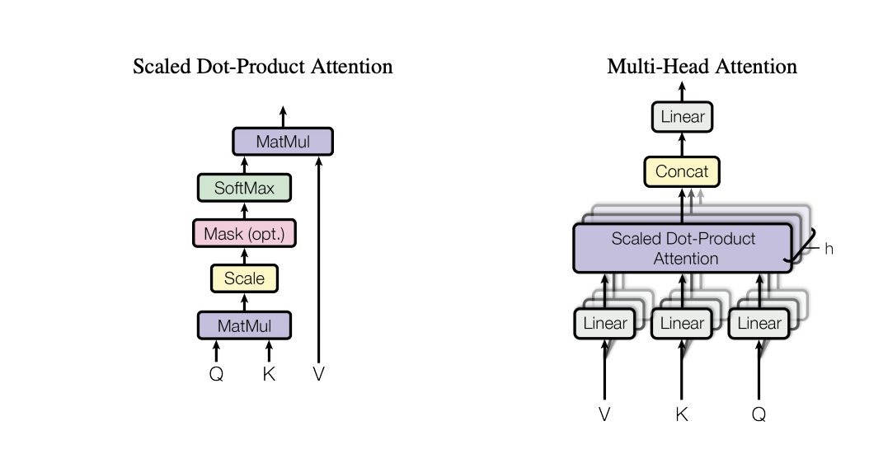
Multihead Attention
From Vasvani et al.

Slide 27
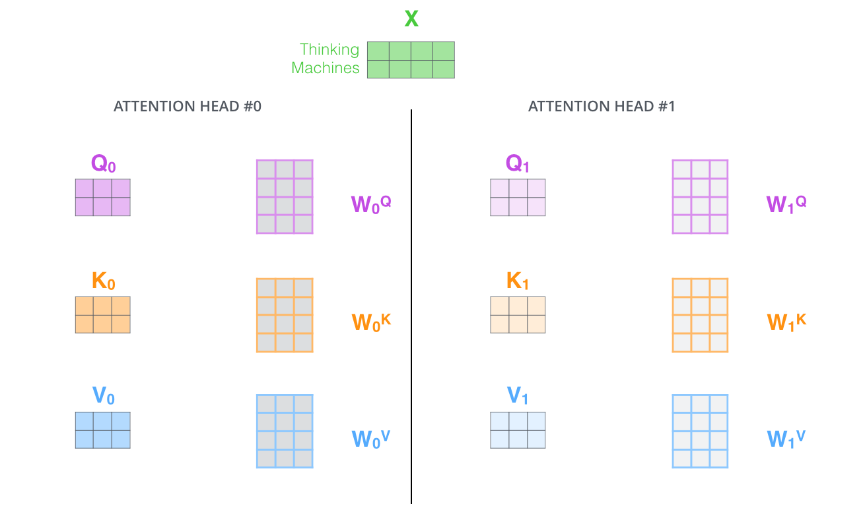
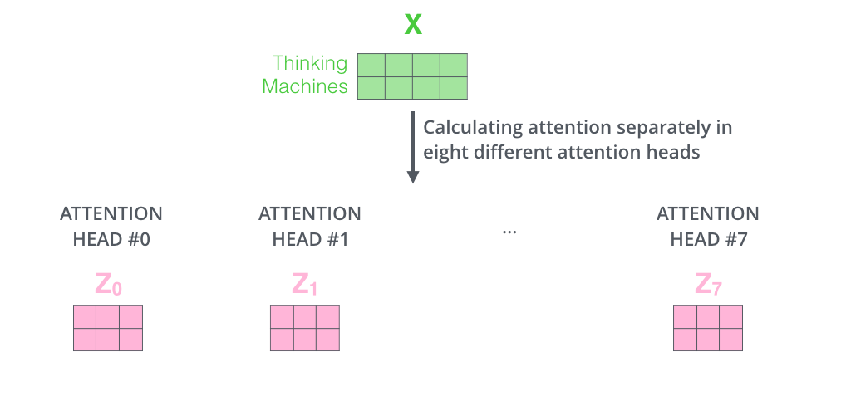
Multi-head Attention

Slide 28
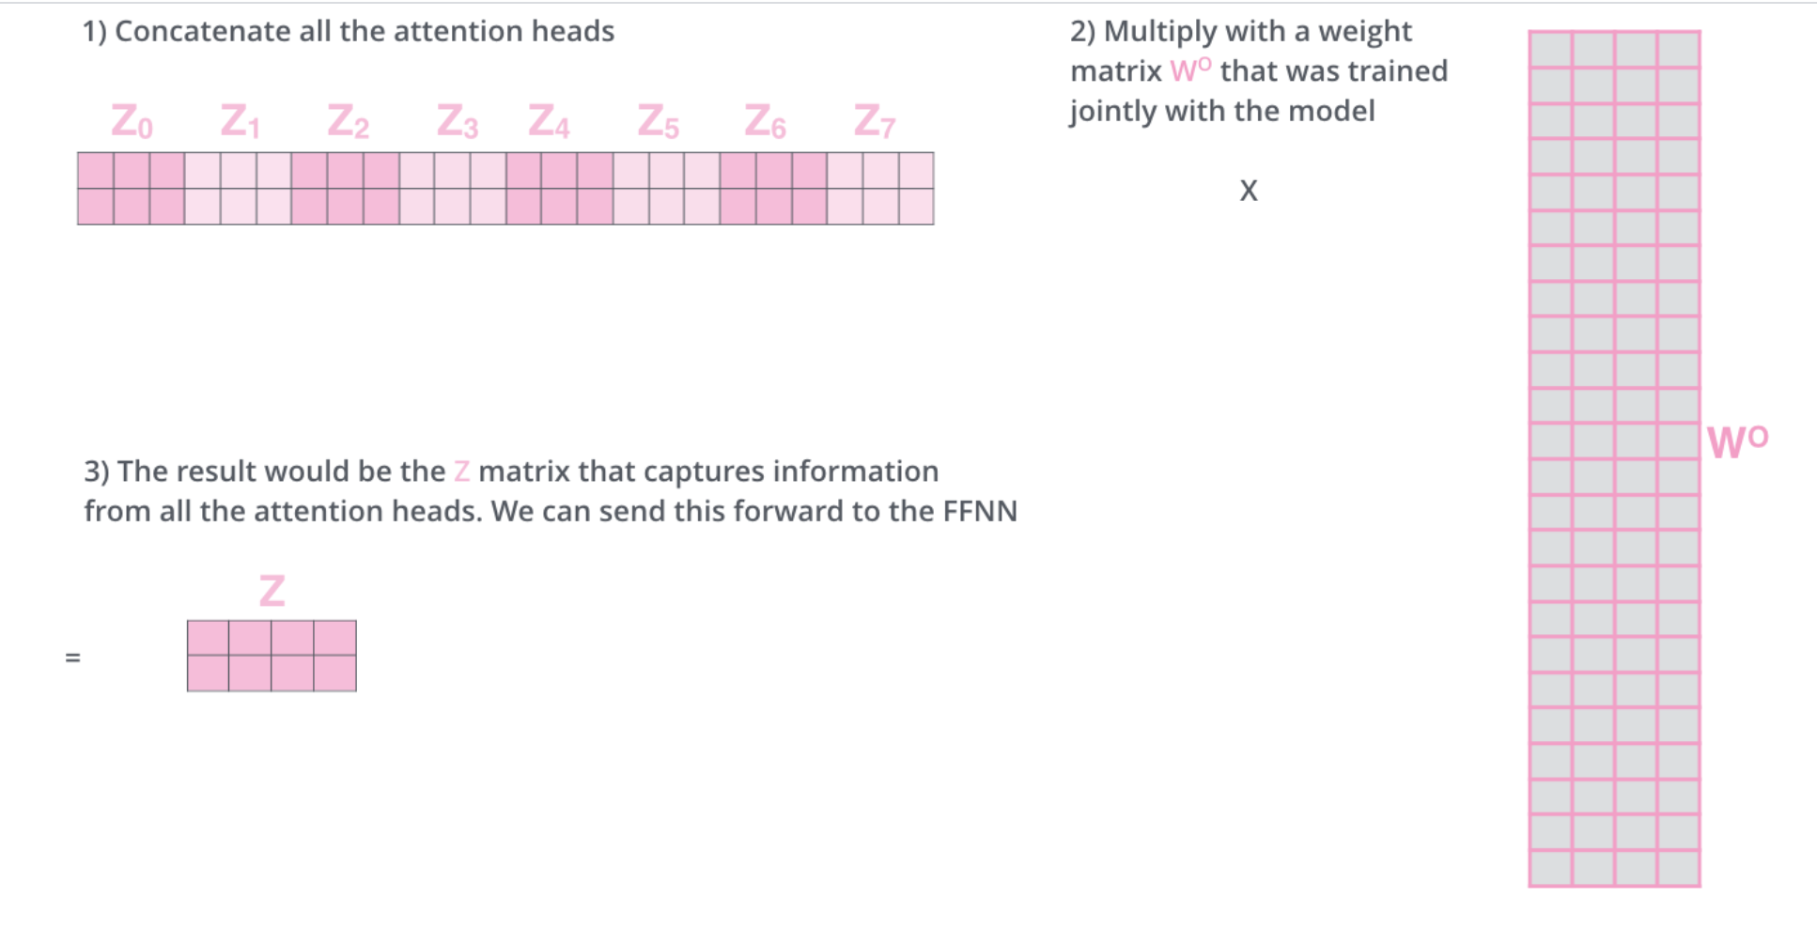
Concatenating Multi-head Attention

Slide 29
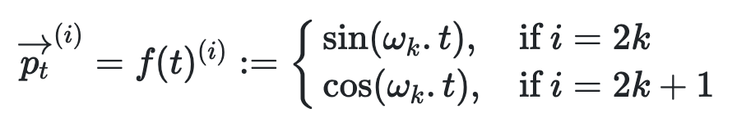
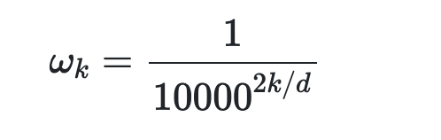
Positional Encoding
Lost positional information now
Positions can’t be encoded by numbers because sequences of different lengths can’t be trained this way
Instead use a periodic function like sin, cos to create the embedding

Slide 30
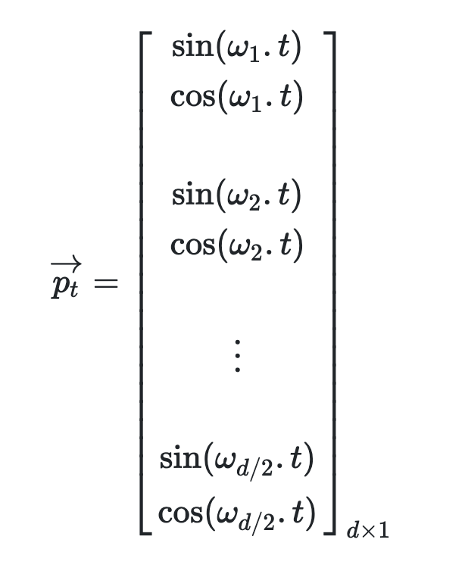
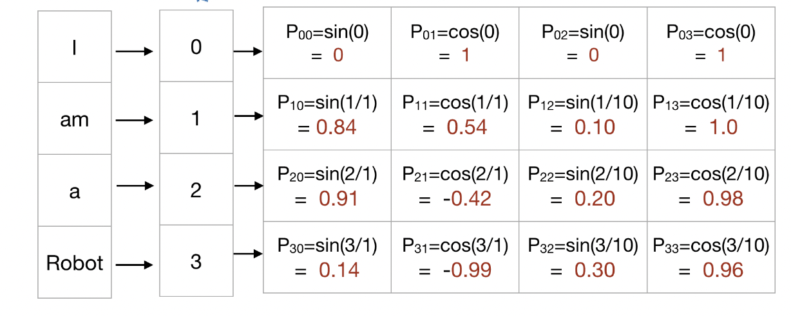
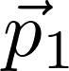
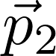
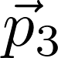
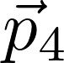
Total positional encoding
d_model
sequence
position t

Slide 31
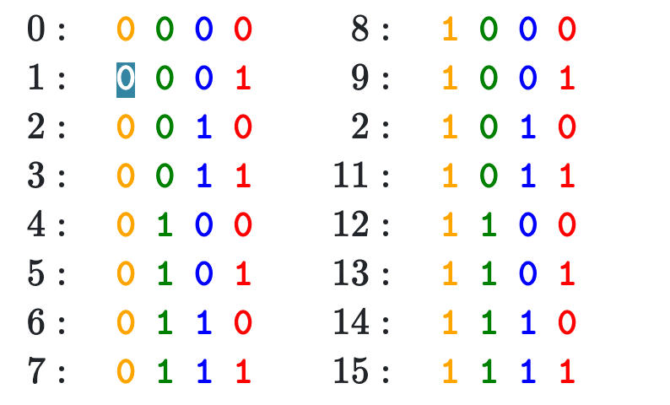

Binary vs Positional Encoding

Slide 32

Transformer
Residuals

Slide 33

Computation in a Transformer

Slide 34
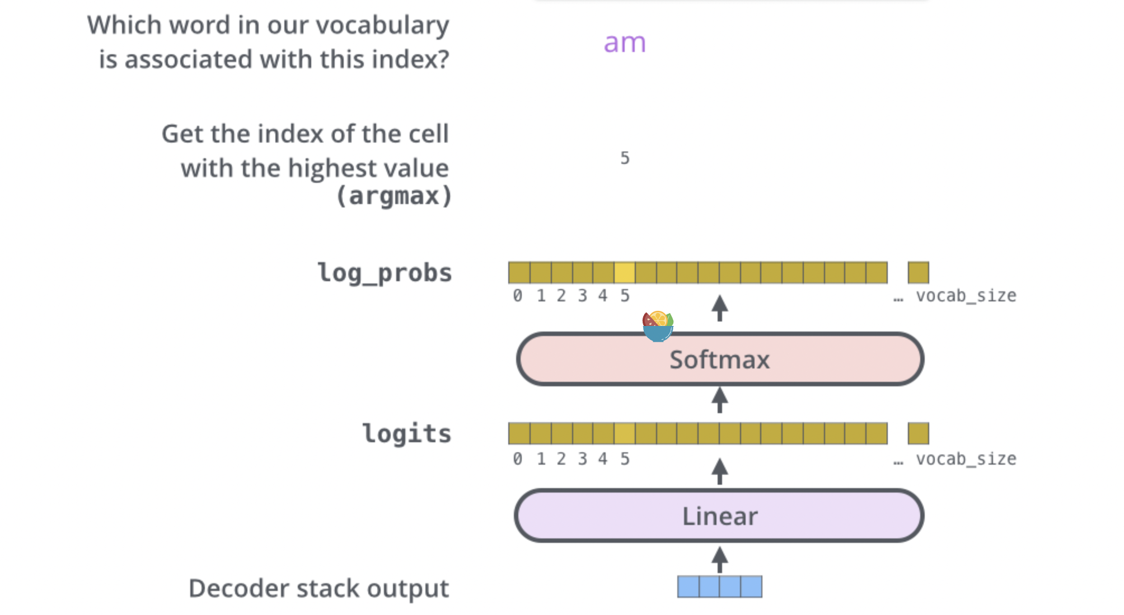
final linear layer and softmax layer

Slide 35
Reading list
https://towardsdatascience.com/attention-and-its-different-forms-7fc3674d14dc
http://jalammar.github.io/illustrated-transformer/
https://towardsdatascience.com/deconstructing-bert-part-2-visualizing-the-inner-workings-of-attention-60a16d86b5c1
https://lilianweng.github.io/lil-log/2018/06/24/attention-attention.html
Vaswani et al. 2019 https://arxiv.org/abs/1706.03762
Radford et al. (GPT2 paper)
Brown et al. (GPT3 paper)
Child et al. (Sparse Transformer)
https://medium.com/walmartglobaltech/the-journey-of-open-ai-gpt-models-32d95b7b7fb2

